Slide 1
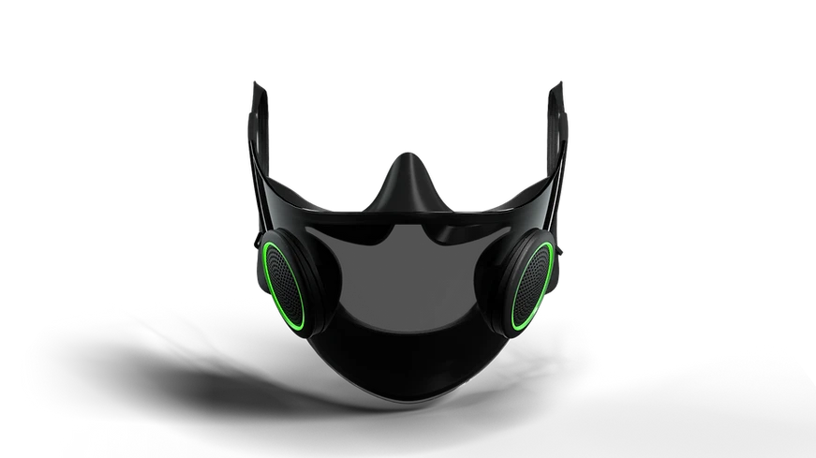
Opencare connect
By OpenCare – a project of Team Smart
Matthew Setiawan, James Ong, Omar Zeidan, Milan Paczai

Slide 2
Problem Description
According to WHO 9/10 people are exposed to unsafe air pollution levels, resulting in 7 million deaths annually.
A recent UK Government report shows that we spend up to 90% of our times inside, where Volatile Organic Compounds, that are major contributors to respiratory, kidney and liver illnesses, can be up to 1000x higher than outdoors
Healthcare professionals, regular visitors at hospitals, and people living in polluted areas who are in need of a solution that can help them protect themselves from harmful pollutants and monitor their physical activity.
Approximately 27 million working in healthcare industry who yearn for a sustainable and smart product.
Reference:
UK Government: https://assets.publishing.service.gov.uk/government/uploads/system/uploads/attachment_data/file/831319/VO__statement_Final_12092019_CS__1_.pdf
US EPA. https://www.epa.gov/indoor-air-quality-iaq/what-are-volatile-organic-compounds-vocs
WHO. (2018, May 31). 7 million premature deaths annually linked to air pollution. Retrieved from https://www.who.int/mediacentre/news/releases/2018/air-pollution-deaths/en/

Slide 3
Our Solution
OpenCare Connect: The ultimate wearable solution offers a comprehensive solution to this problem by combining the functions of a face mask and a wearable device.
The device is designed specifically for healthcare professionals and regular visitors at hospitals, as well as people living in polluted areas, and provides real-time monitoring of air quality and physical activity.
With the ability to measure steps and heart rate, these groups of people can now have peace of mind and stay protected everywhere.

Slide 4
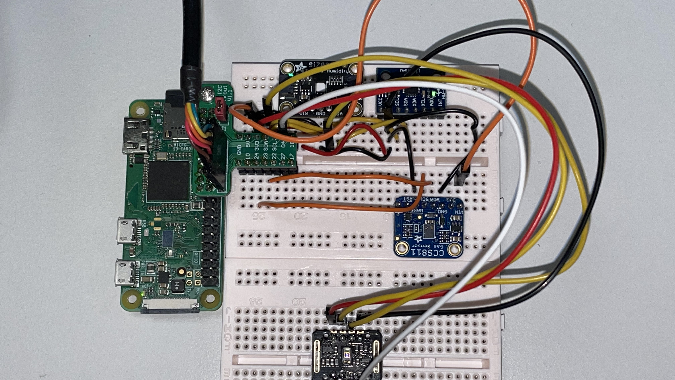
OpenCARE

Slide 5
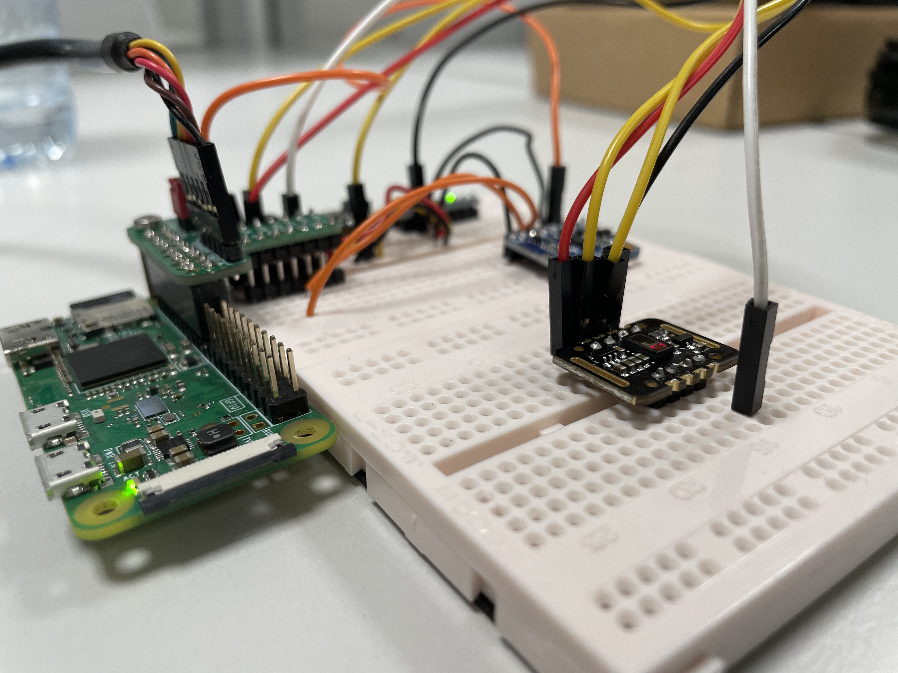
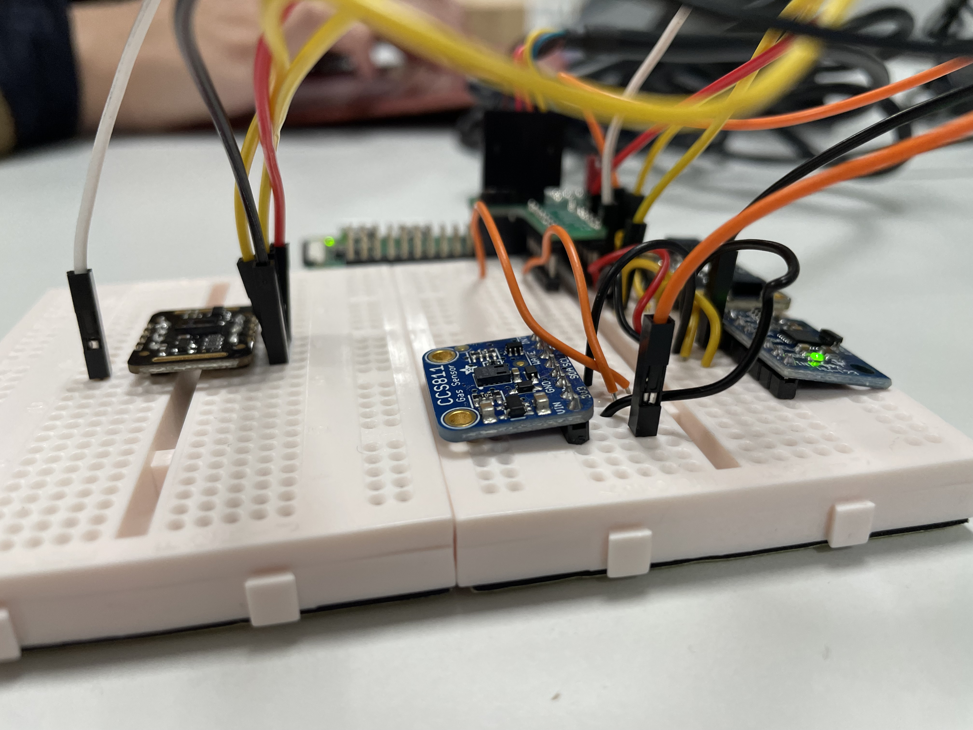
Sensors
Accelerometer
CO2 and VOC sensor
PPG sensor
Temperature and Humidity sensor

Slide 6

Multithreading
Implemented multithreading on raspberry pi boards
Enhanced real-time sensor readings

Slide 7
Super loop vs multi-threads
Super Loop | Multithreading
Straightforward implementation | Provides fast response times
Suitable for low data volumes and low data rates | Concurrent readings and MQTT publishing
Slow response time + backlog | Proper synchronization needed – debugging, etc
A 'slow' sensor bottlenecks the system

Slide 8
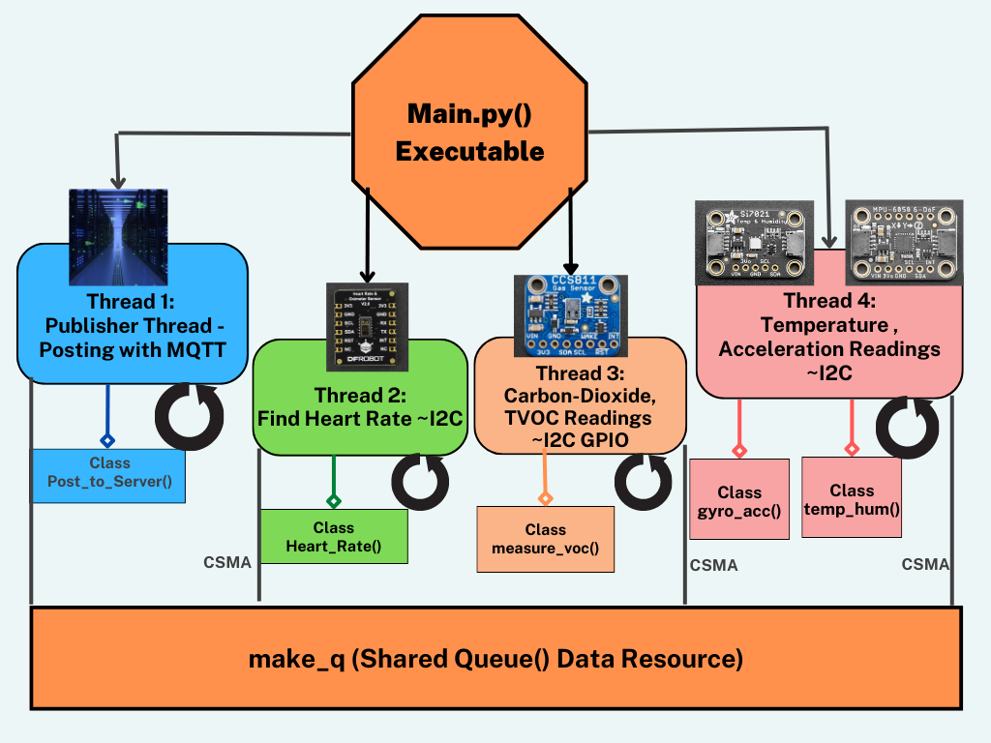
Diagram of Threading

Slide 9
Demonstration
On Matthew's Computer

Slide 10
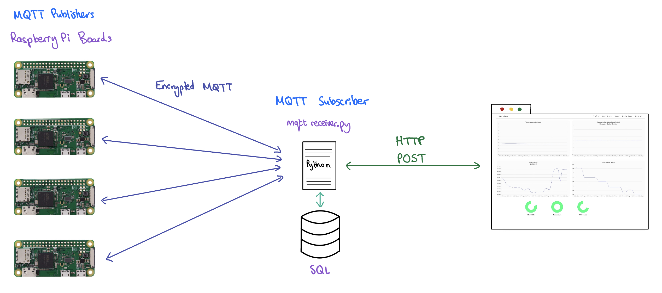
Networking

Slide 11
Networking
MQTT | HTTP
MQTT Publisher on each Raspberry Pi associated with each user as a publisher. | Used between the backend MQTT subscriber and the frontend of the website.
Used in a Python file in the Django backend of the website as an MQTT subscriber
Lightweight messaging protocol that is designed for IoT applications. | Well-established protocol that is widely used on the web.
Provides low latency, high throughput, and efficient use of network bandwidth. | Compatible with a wide range of devices and platforms.
Supports a publish/subscribe model, which allows multiple subscribers to receive data from a single publisher. | Easy to use and can be integrated with other protocols and technologies.
Small code footprint and is easy to implement. | Reliable and provides error detection and correction.

Slide 12
Advanced features
CSMA inspired access
protocols
Live Readings
(Ultra-low latency readings)
Real-time PPG heart rate processing
Median filtering -> Gaussian Smoothing
Multithreading

Slide 13
Additional features
RSA Encryption with MQTT
Machine Learning – activity identification
Step detection algorithms (noticed erratic acceleration etc.)
Heart rate data processing.
Pen testing for security
Leaderboards
Robust Integration Testing
Works with multiple boards

Slide 14
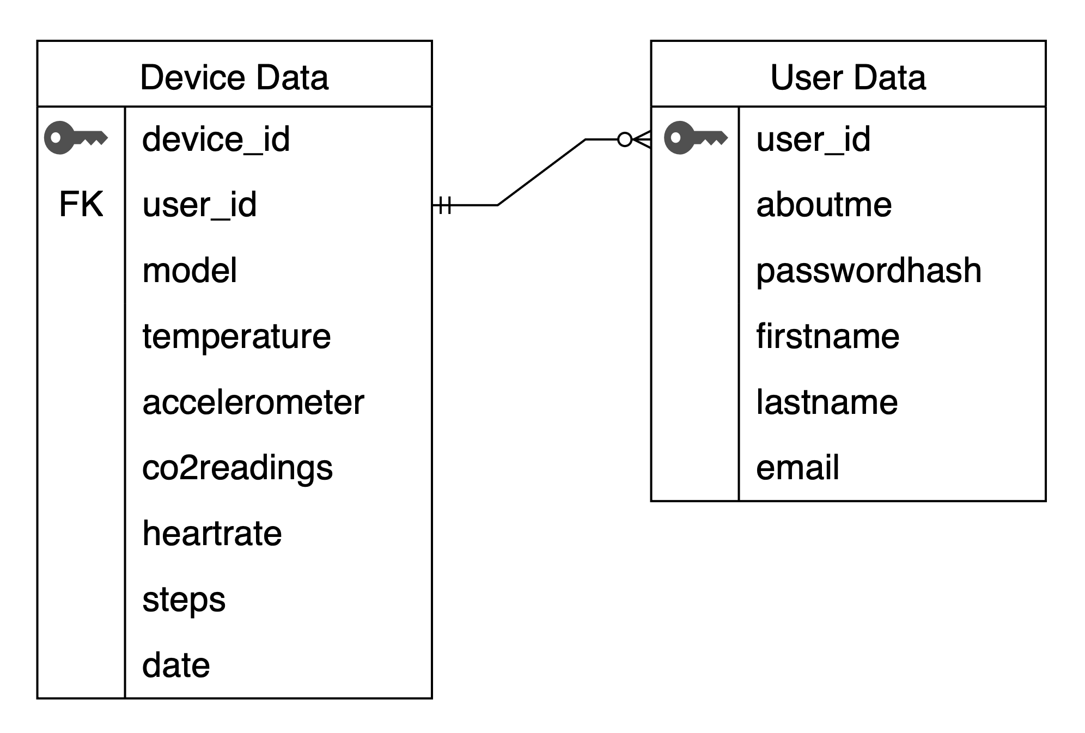
DATABASE ENTITY RELATION

Slide 15
Scale-up plan
Singapore Hospital Employees
Singapore general public
UK Launch

